Slide 1
World Changers
Authentic Student Research Assignments Creating real Change
Jenifer Gearhart
jgearhart@k12.wv.us
@Msgearhart11
Elizabeth keiper
ekeiper@k12.wv.us
@keiperet1

Slide 2
Why service learning?
According to the National Council for Educational Statistics, Service Learning is “curriculum-based community service that integrates classroom instruction within community service activities.” (Westatt and Chapman, 2-3)
True Service Learning is more beneficial to students than simply Community Service
Source:
Westatt, Rebecca, and Chris Chapman. "Service-Learning and Community Service in K-12 Public Schools." National Council for Educational Statistics (1999). Web. 25 Mar. 2017.

Slide 3
Why Authentic Writing?
“It is all about purpose and audience. Who is going to read this and what impact will the writing have on the world outside of the classroom? Without those two things, students lose a lot of their motivation and don’t see the applications of classroom content outside of school. They often see their assignments as things that only apply to the Language Arts classroom.” –Josh Stock
“I believe authentic writing has to do with the student expressing or finding his or her voice – the purpose is secondary.” –Susan Barber
Source:
Sztabnik, Brian. "Authentic Writing: What It Means and How to Do It." Talks with Teachers. N.p., 20 Dec. 2015. Web. 25 Mar. 2017. <http://talkswithteachers.com/authenticwriting/>

Slide 4
General Project overview
Your Mission:
Choose a problem that exists in your community, the nation, or the world which interests you.
Research causes and solutions for your chosen problem.
Write a research paper arguing causes of the problem (why the problem is a problem) and a solution (how the problem may be combatted). Points = 100
Write a proposal of something that YOU could do to motivate Spring Mills High School students to take action against this problem. Points = 50
*These proposals will be read by a committee of teachers and staff, and one will be chosen to be actually implemented here at school.

Slide 5
The Research phase

Slide 6
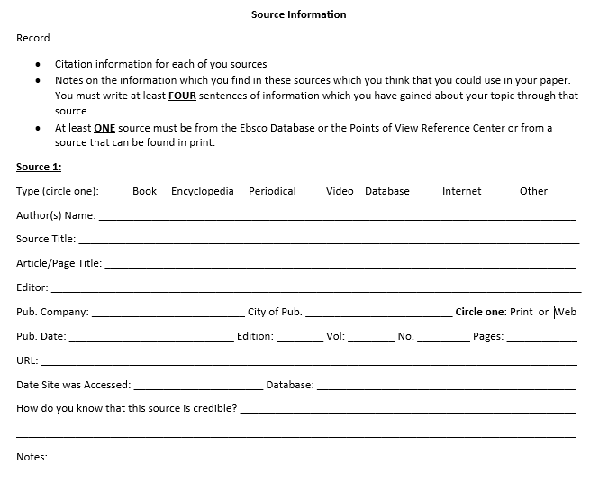

Slide 7
The Writing Phase

Slide 8
Writing a Thesis
A thesis is arguable and gives the reader a snapshot of what you claim in your project.
Problem + Location Focus + Cause 1 + Cause 2 + Cause 3
Example:
World hunger remains a problem in the world today due to generational poverty, corrupt political systems, and a lack of start-up funds for impoverished families.

Slide 9
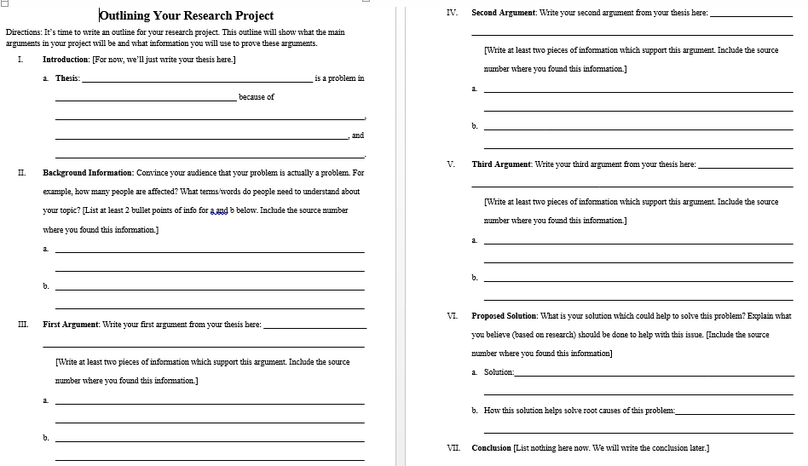

Slide 10
Parts of an introduction…
+ Thesis statement
(purpose of your essay)

Slide 11
Topics Covered in research notes
Intro to concept of In-Text Citations
MLA Format for In-Text Citations
Example of correct usage of In-Text Citations
Plagiarism
Quote Incorporation
Writing Body Paragraphs
Writing a Conclusion
Revision
MLA Formatting Guide

Slide 12
Differentiated Final Products in the Writing Phase
Traditional Research Paper
Skeleton Paper in PowerPoint Form
Editorial News Piece with Infographic

Slide 13
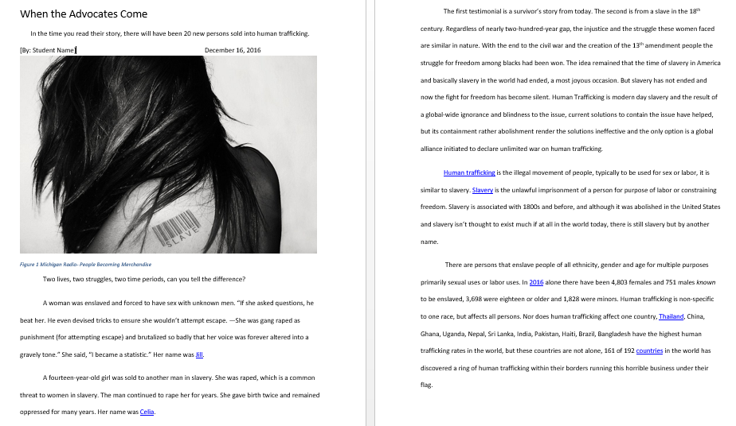

Slide 14
Infographics: Piktochart

Slide 15
The Proposal Phase

Slide 16
The Proposal Phase—Brainstorming your Proposal
Think about the CAUSES of your problem which you argued in your paper. What contributes to making your problem a problem?
Example: World hunger remains a problem today due to generational poverty, corrupt political systems, and a lack of start-up funds for impoverished families.
Find a solution which addresses one or more of the causes of your chosen problem.
Example: The Heifer Project gives farm animals to families in third world countries. This combats generational poverty and a lack of start-up funds because it gives them a sustainable resource that will continue to produce revenue into the foreseeable future.

Slide 17
Types of Solutions
Raising money: For many of your researched problems, organizations already exist which combat this problem. You may mobilize the school to raise money for this organization.
Raising awareness: For some of your problems, the fact that students at Spring Mills are unaware of this problem is the biggest contributing factor to the problem itself. You may want to create a poster campaign, bring in a guest speaker, or hold an assembly to inform the student body about your chosen problem and motivate them to action. Create an advertising plan.
Working towards legal action: For some of your chosen problems, legal action must be taken to make any steps toward a solution. You may want to mobilize students at school to write to or visit members of the school board, the city council, or even the state or national congress to discuss your concerns and ask them to work towards a solution.

Slide 18
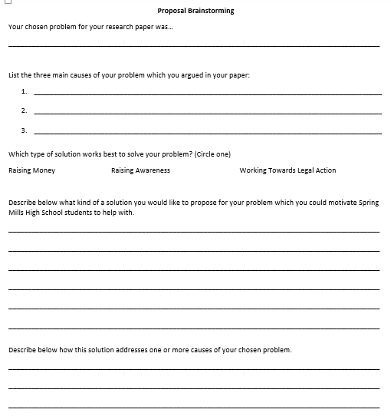

Slide 19
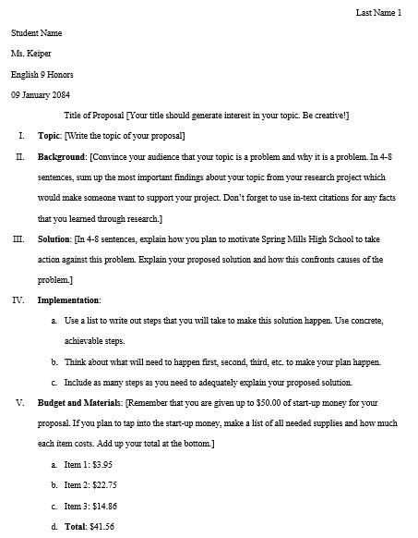

Slide 20
Results of the Proposal Phase

Slide 21
Dr. Jennifer Orlikoff at Spring Mills High School, May 2016

Slide 22
National Coalition for Homelessness Speakers’ Bureau

