Slide 1
Research Basics

Slide 2
Making an outline
Using Word:
Type I. (Capital “I” period space), hit enter
This will create automatic formatting in Word for an outline
Hitting Enter will set up the next section of the outline (II)
To create subpoints (a, b, c, d etc). Hit tab after hitting Enter.
To go back, hold shift and tab at the same time
Your outline should look something like what is on the next slide . . .
* You do not have to use Word. You may use OneNote or a similar tool. But, your outline must be organized and DETAILED

Slide 3
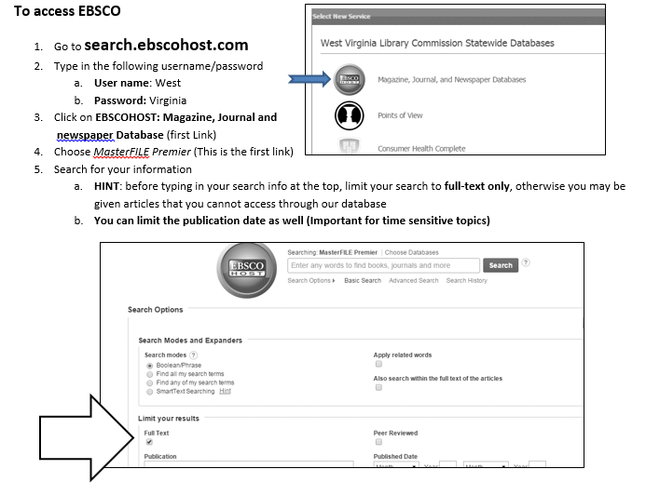
Using EbSCo

Slide 4
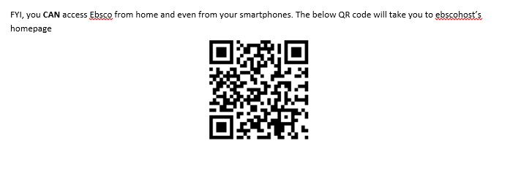

Slide 5
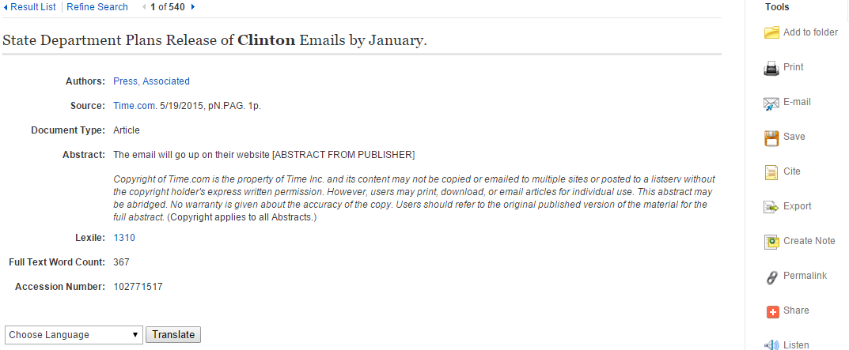
Cite Ebsco Sources . . .
Ebsco makes it easy to cite the sources you find there . . .
Click Here

Slide 6
Cite Ebsco Sources
Make sure to select the MLA citation. Copy and paste it into your bibliography. Make sure to keep the hanging indent formatting!

Slide 7
Remember you can’t believe EVERYTHING you read, especially online.
Make sure to use the following tips before you use ANY source.
Authority:
Who says? Know your author!
WHO created this information and WHY?
Do you recognize the author and their work?
How does the author back up their points? Do they provide their sources?
Does the author acknowledge other viewpoints/ theories?
Objectivity:
What is the bias of the information?
Is the information fact or opinion?
Is the source one sided?
Who sponsors the site? What influence might they have?
Is the information meant for entertainment: humor/parody/satire?
Authenticity/ Reliability:
Who else has reviewed the information?
Are sources given for where the information was gathered?
Are sources trustworthy?

Slide 8
Evaluating Resources
URL’s and their meanings:
.gov: posted by gov’t group or agency
.edu: educational
.org: nonprofit organization (Who sponsors the site? What is the bias?)
.com: business/generic site.
.net: variety of org. offering services.
Timeliness
When was the site last updated?
Are links/ sources updated?
Is the information current?

Slide 9
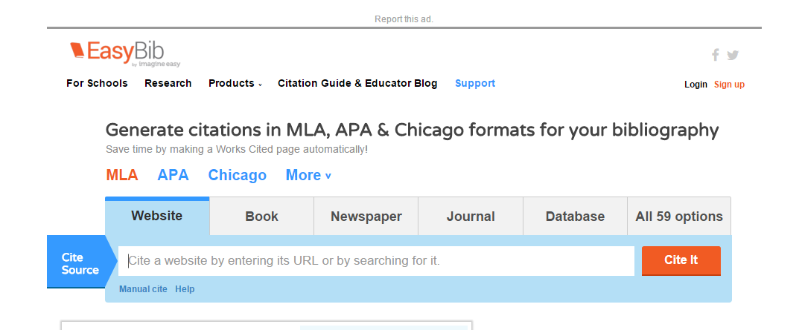
Using Easybib
Go to: easybib.com
Click Here

Slide 10
Using Easy Bib
Make sure to choose the appropriate category for what you are citing. There are 59 options!
Most of your sources are probably websites, so use the website tab
REMEMBER, if you select an online source that is not a normal article (example, a video, a graph, a picture), make sure to choose the correct option.
Although you can copy and paste the URL, I suggest using the “manual cite” option so that you can plug in all of the information from your source card
Fill out as much information as you can find from your sources
If you choose to use the quick cite option, make sure that the citation easybib gives you is CORRECT.

Slide 11
Making bibliography
2 Options:
1. Copy and paste each individual citation into word. Makes sure to maintain hanging indent
2. Export the bibliography from easybib.com to Word… follow directions on next slide

Slide 12
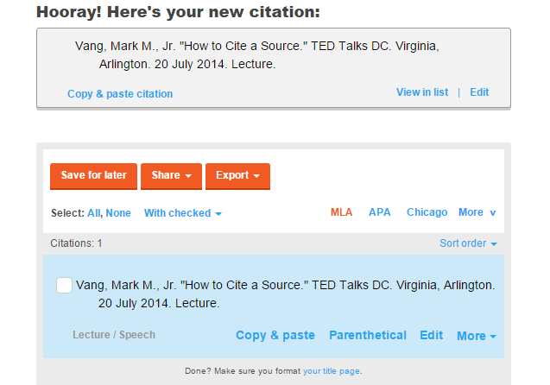
Making a Bibliography
Click Here

Slide 13
Filling Out Source Cards
Include AS MUCH INFORMATION AS POSSIBLE
Source Title & Article Title are not the same thing . . . Use the right one!
Source Title: Overall source (Time Magazine, New York Post, Purdue)
Article Title: Individual Page (“How Paris affects 2016 elections)
Date of access and publication date are also different
Date of access: Today’s date
Publication Date: When it is published (should be towards top of the page. If you can’t find this, copyright of the page is acceptable– this should be at the bottom of the page)
Things you won’t find generally on internet sources
Editor
Place of publication
Volume, Pg # (If this is an online magazine or something that is also published in print, you WILL NEED TO INCLUDE THIS)

Slide 14
Citation Review
When to cite:
After paraphrased information
After summarized information
After quotations
Cite any information that is not your own insight or analysis. That means that there should generally be AT LEAST 1 citation per paragraph

Slide 15
Citation Review: In text Citations
The Basics . . .
Cite with Author’s last name 7 & page # (if internet source with no pg, just last name)
Ex: (Andrews 89)
If there is no author, cite with an abbreviated version (generally 2-4 words) of the article title
Ex: (“Clinton’s Strengths”)
Make sure that this MATCHES the bibliography– Look at bibliography. What is the first word of the citation? This should be what is in the in text citation
PUNCTUATION COMES AFTER CITATION

Slide 16
Incorporating quotations
NO QUOTE BOMBS
You MUST incorporate any quotes into the sentences!
Give context before or after the quote:
Clinton said “ . . .”
What if it is a quote from someone other than the author of the article??
(Clinton qtd. in Richmond)

Slide 17
Avoiding redundant citations
If you are including a quote from your candidate and you already make it clear that it is the candidate speaking, cite with the article title
Clinton said “ . . .” (“Announcement Speech”)
Or . . . Mention the speech in the lead in to the quote. You can avoid a citation entirely
In her announcement speech, Hillary Clinton said “ . . .”

Slide 18
Formatting of Essay
Double Spaced
Times New Roman 12 Point font
1 inch margins

Slide 19
Final things to remember . . .
This is at its heart AN ARGUMENTATIVE essay. Make sure that you are creating and DEFENDING an argument
Do not just summarize information about your issue. EXPLAIN why this information is important to making a change (and why that change is important!)
Make your sources work for you. Your argument is central. The sources should be used to back up your points. Not the other way around

