Slide 1
Mock Interviews
What you need to know

Slide 2
The Portfolio
Interviewers will expect to see:
An evaluation form with your information at the top
A resume (authentic and up to date)
Letters of recommendation
A cover letter
A job application
All these materials should be:
Completed
Neat
Organized

Slide 3
The Process
1st – 5th period English classes:
You will interview during your English class.
You will be called down as a group.
6th – 7th period English classes (potentially 5th period as well):
You will be called out of one of your morning classes to interview (1st – 4th)
If you are leaving early due to a sporting event, please interview during 1st period after informing your teacher. If you need a note, see Mrs. Uccellini.

Slide 4
The Process (cont.)
Interviews take place in the library:
When you arrive, sit in a chair in the front and wait to be sent to a table
Each table is numbered
Students will be interviewing at the same time at tables around you
Try not to lose focus or let this interfere with your interview

Slide 5
The Process (cont.)
When you finish your interview:
Shake hands with your interviewer (again)
Leave your portfolio with the interviewer
He/she will complete your evaluation, give your portfolio to an assigned helper, and the portfolio will be given to your English teacher by the end of the day
Go back to your current class immediately

Slide 6
The Process - Timing
The overall interview process can take anywhere from 10 – 30 minutes
Factors that may affect your time:
Wait time if all tables are taken when you get to the library
Some interviewers like to chat
Some interviewers like to ask more questions than others

Slide 7
Other Interview Responsibilities (related to timing)
You are fully responsible for:
Getting any missed work if you have to leave a class or if your interview runs over into another period
Turning in any work that is due if you miss a class or get there late due to your interview
Getting to and from your interview in a timely manner
(If a teacher requests) Getting a written note for leaving/showing up late to a class due to your interview

Slide 8
The Evaluation Form
Filling out your information (at the top):
Teacher’s Name:
Your current English teacher
Position Desired:
What you would like to be in your future career (Ex. Teacher, physical therapist, mechanic, etc.)
Career Cluster
The cluster your desired future career falls under
Career Major:
What you will major in while in college to achieve your desired career

Slide 9
Career clusters
Agriculture, Food & Natural Resources
Architecture & Construction Arts,
Technology & Communications
Business Management & Administration
Education & Training
Finance Government & Public Administration
Health Science
Hospitality & Tourism
Human Services Information Technology
Law, Public Safety, Corrections & Security
Manufacturing Marketing
Science, Technology, Engineering & Mathematics Transportation,
Distribution & Logistics

Slide 10
The Evaluation Form
The Categories:
Appropriate dress
Eye contact
Handshake/greeting
Confidence
Enthusiasm
Listens to questions
Answers questions appropriately
Proper grammar
Portfolio

Slide 11
The Evaluation Form
The interviewer will mark the following:
1 – 5 in each listed category
1 = Unacceptable, 5 = Excellent
Whether he/she would hire you, consider you, or would not hire you
Comments on your interview
His/her name and company address
You will use this to send a thank you letter

Slide 12
The Grade
Category scores will be added together to reveal your overall score
The interviewer determines your overall score; I will determine your grade based on that score.
If an interviewer marks that he/she would not hire you, you will receive a failing grade

Slide 13
Appropriate Dress
The FIRST thing interviewers judge you on as you walk toward them is the appropriateness of your dress
Be sure to dress formally and appropriately
If you need help getting/finding an appropriate outfit, please see me immediately and I’ll try to help!

Slide 14
Girls
Appropriate Outfits
Inappropriate
Dress pants, dress shirt, moderate heels
Dress and moderate heels
Dress shirt, skirt, moderate heels
Business suit (skirt or pants) and moderate heels
Shoes should NOT be open-toed. Flats are not recommended unless they are “dressy.”
Jeans/shorts
Low-cut shirts
Shirts with wording/random images
Short skirts/dresses
Tight clothes
Super tall high heels
Excessive jewelry/piercings

Slide 15
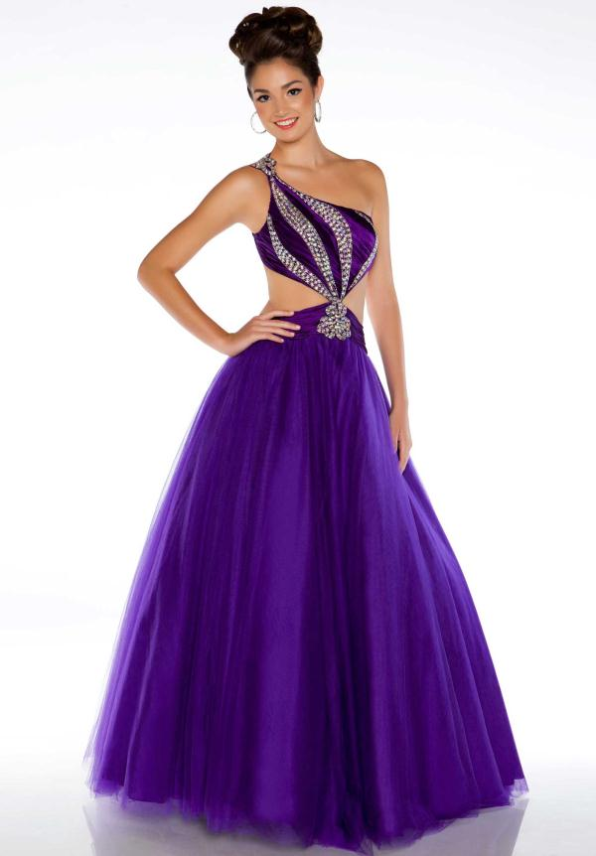
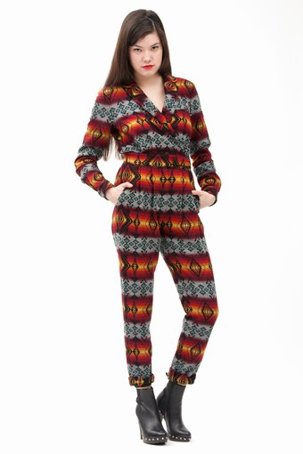
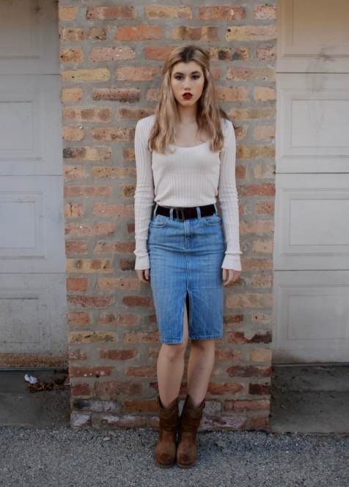
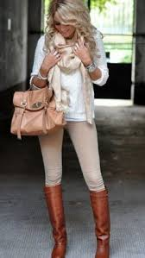
What not to wear…

Slide 16
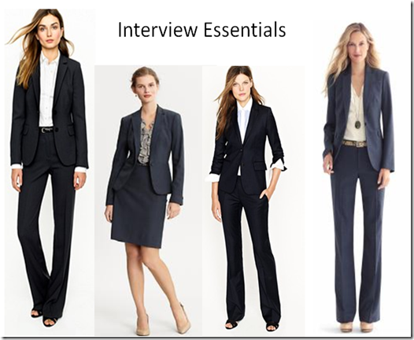
What to wear…

Slide 17
Guys
Appropriate Outfits
Inappropriate
Suit and tie
Dress pants, dress shirt, and tie
Dress pants and dress shirt (no tie)
Dress pants and a very nice polo shirt (only if you don’t have a dress shirt)
All should be worn with formal dress shoes and DARK socks
Jeans/shorts
T-shirts
Shirts with inappropriate wording/random images
Sneakers or any informal shoes/boots
Excessive jewelry/piercings
Tuxedo
Leather

Slide 18
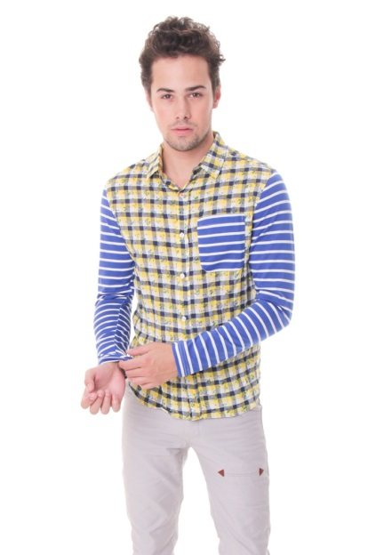
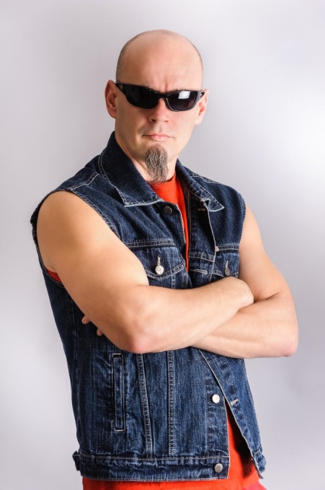
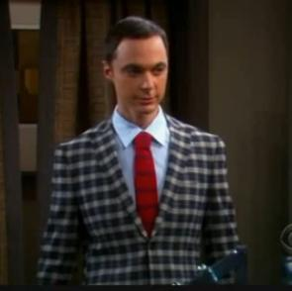
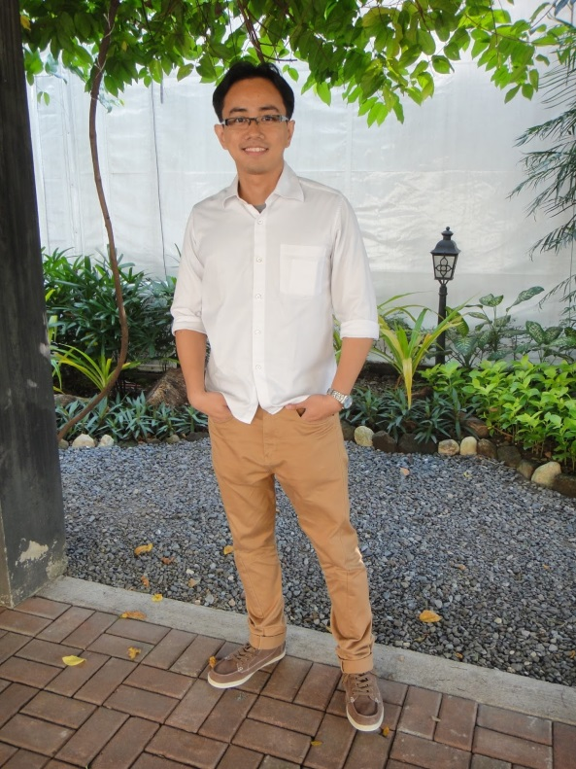
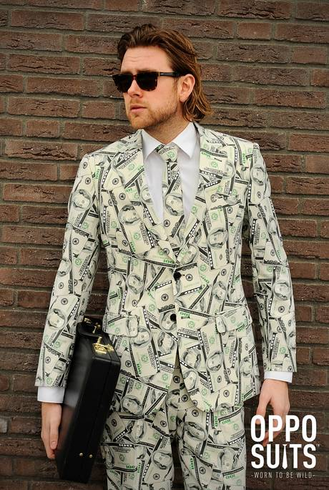
What not to wear

Slide 19
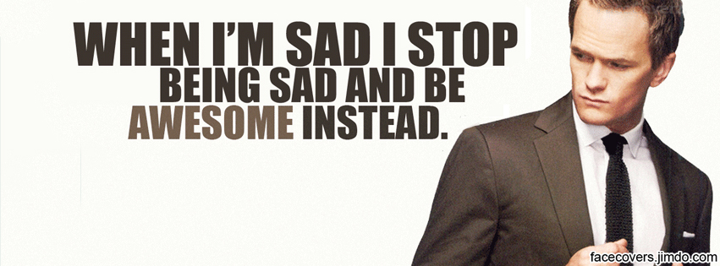
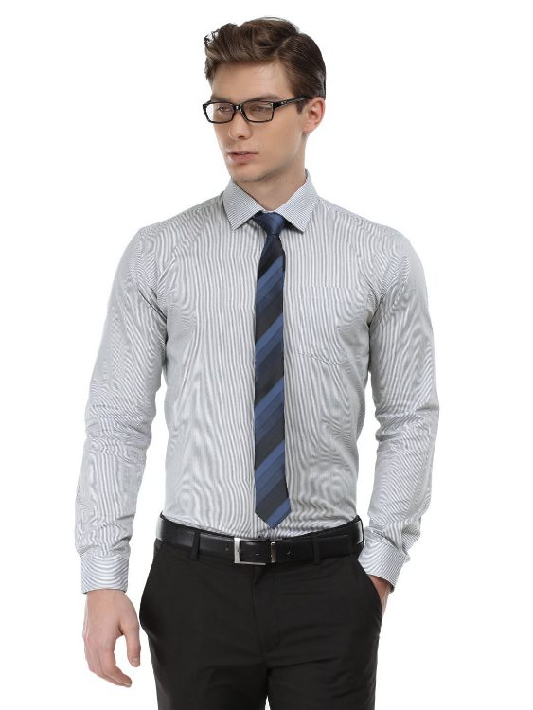
What to wear…

Slide 20
A few last notes:
Interviewers are told to only question you about the resume in your portfolio
However, some will forget and ask you about the fake cover letter/application
Calmly explain that the cover letter/application were just practice assignments. Then, let them know they can question you about anything on your resume because it is legitimate.

Slide 21
A few last notes:
Each interviewer is different:
Some will score harder than others
Some will interview much longer than others
Follow what you have been taught about interviews and you will do well no matter who your interviewer is!

Slide 22
Don’t Forget
Give a good handshake and introduce yourself
Shake hands again at the end of the interview
You can always ask the interviewer to repeat or rephrase a question – just do so politely
Keep in mind that this is an invaluable tool to HELP YOU find a good job, so…
Smile!
Relax – you are not in an interrogation room!
These men and women are nice people from the community who have volunteered to interview. They want you to do well! Some of them might even spark up a nice chat with you when the interview is over ☺

Slide 23
GOOD LUCK!!!

