Slide 1
Infographics in the Classroom
Jeni Gearhart
Hedgesville High School
jgearhart@k12.wv.us
@MsGearhart11

Slide 2
What is an infographic?
Definition: a visual image such as a chart or diagram used to represent information or data.
Infographics are mostly visual
Includes:
Symbols (Ex: Arrows connecting topics)
Intentional color/sizing of objects to demonstrate importance
Charts/diagrams

Slide 3
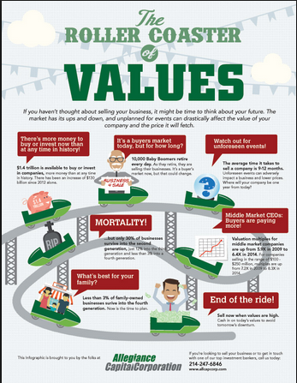
How does the organization influence the message?

Slide 4
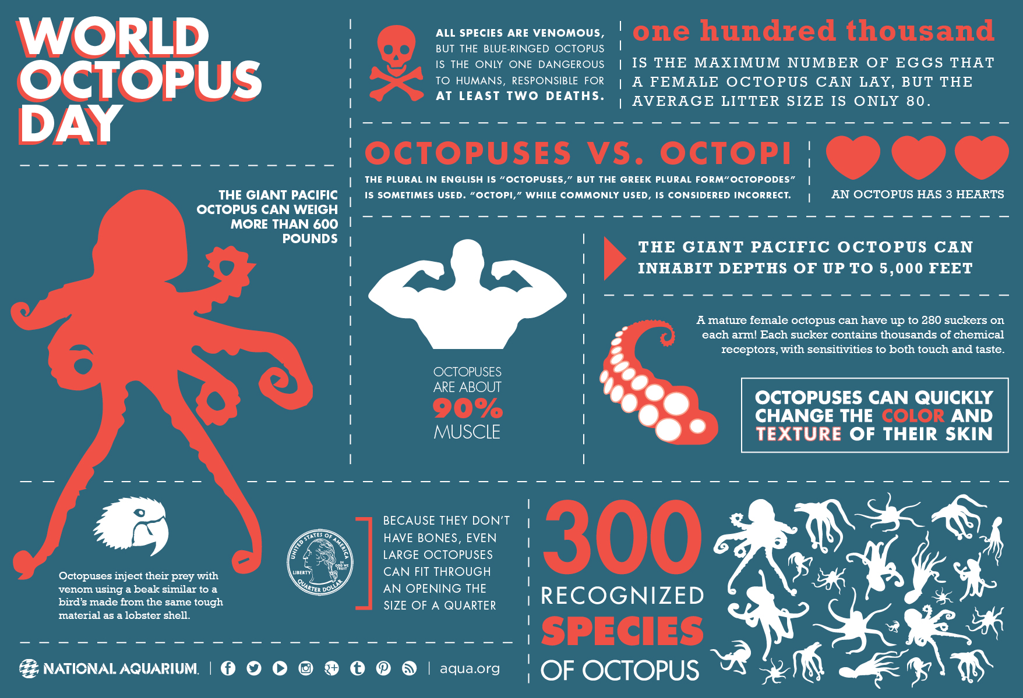
How does the organization influence the message?

Slide 5
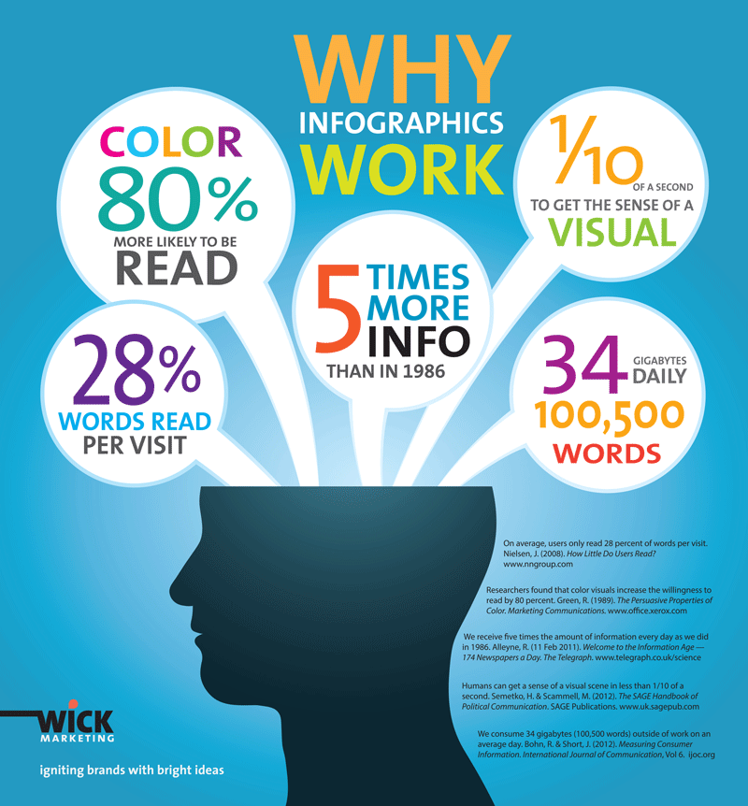
How does the organization influence the message?

Slide 6
Infographics in My Classroom
1984 Goldstein’s Book (Low-Tech)
To Kill a Mockingbird Themes (Low-tech)
2016 Election Research Paper
2017 Advocacy Research Editorial

Slide 7
Infographics: Summarizing Students visually display their knowledge of a large piece of text
10th Grade novel 1984

Slide 8
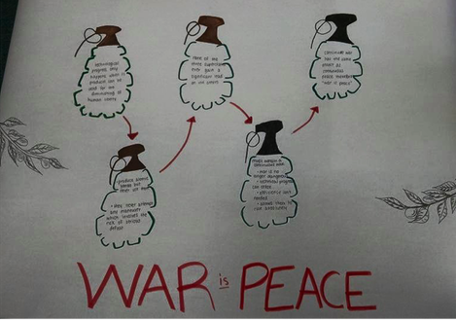
Infographics: Summarizing Students visually display their knowledge of a large piece of text
10th Grade novel 1984 (Low Tech)

Slide 9
Theme/Character Students visually display Character Knowledge
10th Grade novel To Kill a Mockingbird (Low Tech)
Credit: Liz Keiper

Slide 10
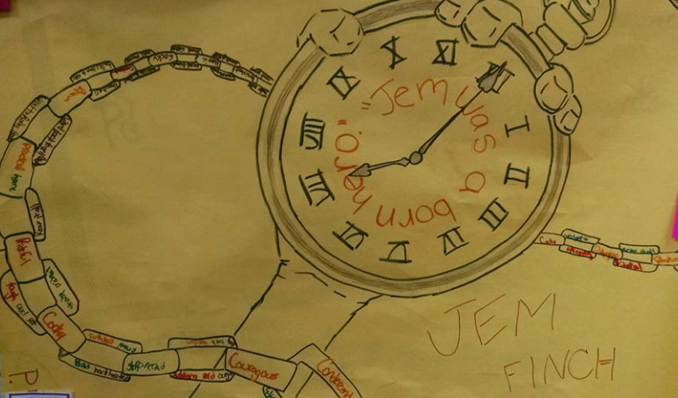
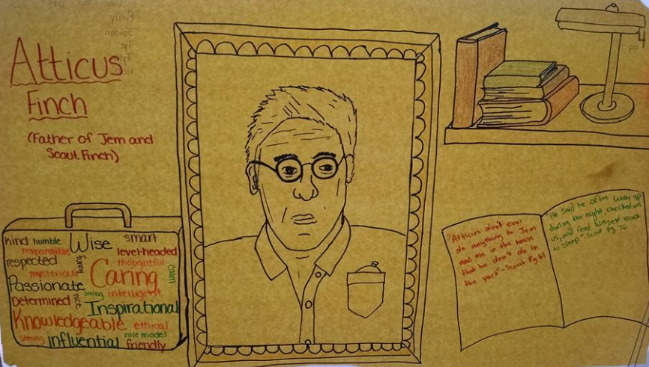
Theme/Character Students visually display Character Knowledge
10th Grade novel To Kill a Mockingbird (Low Tech)

Slide 11
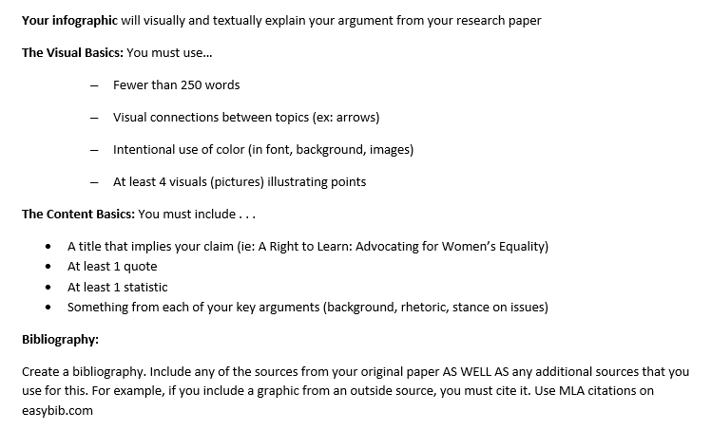
Research Display data and research (after formal research paper)
AP Lang: 2016 Presidential Candidate Research Paper & 2017 Advocacy Editorial

Slide 12
Student Examples
Into the Mind of Bernie Sanders (2016 election project- AP Lang)
The Problem with Food (2017 Advocacy Project- AP Lang)
What it Takes to Learn (2017 Advocacy Project-AP Lang)
Where’s Her Money? (2017 Advocacy Project- AP Lang)

Slide 13
Why infographics?
So much learning! Standard-wise, it targets understanding and evaluation of informational argument, research, and use of technology.
It is real life. These infographics look professional. Students encounter things like this every day and now they know how to interpret and evaluate it.

Slide 14
Infographic options
Piktochart
https://piktochart.com/
Easel.ly
https://www.easel.ly/
Canva (desktop and Ipad app)
https://www.canva.com/
Venngage
https://venngage.com/

Slide 15
Piktochart | Canva | Easel.ly | Venngage
Best on Desktop Easy to use premade templates Charts and other tools to create from scratch (This is the only one I’ve used in my class thus far ) | IPad app and Desktop Can save as PDF Best for: posters, marketing materials (Not good for Data visualization) Simple templates | Ipad App and Desktop Premade Templates or Create from Scratch | Best on Desktop Premade Template or create from scratch

Slide 16
Teacher Example Visual Syllabus
Credit: Kate Harpel

Slide 17
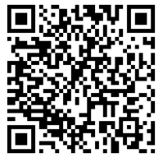
Find my ppt & resources here
http://gearhartclass.weebly.com/bcs-geek-week-2017-infographics.html
Contact
jgearhart@k12.wv.us
@MsGearhart11

