Slide 1
Quickwrite #1
https://www.youtube.com/watch?v=q0qD2K2RWkc
React to the video.
What are some labels that you claim, or ones that you desire to reject?
How do the words we use affect how we view ourselves and others?

Slide 2
Dehumanization
Treating someone as if they are not a human being or are less than human

Slide 3
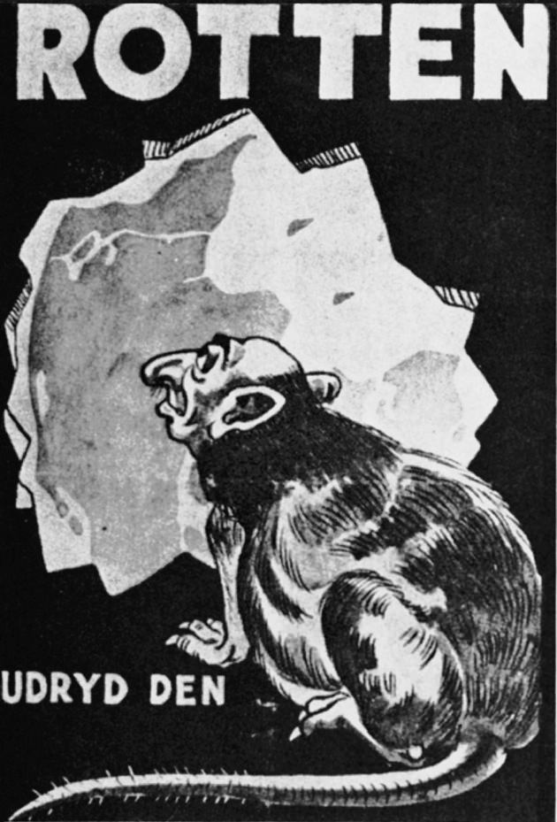
1.
“Rats. Destroy Them,” a 1940s poster from occupied Denmark

Slide 4
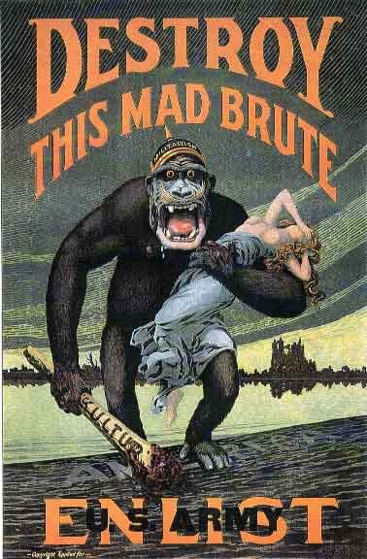
2.
A poster encouraging Americans to join the military during WWI

Slide 5
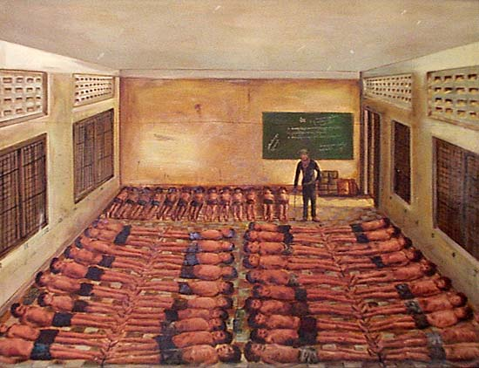
3.
This is how prisoners were kept in cells in Tuol Sleng, the high security execution center, during the Cambodian genocide.

Slide 6
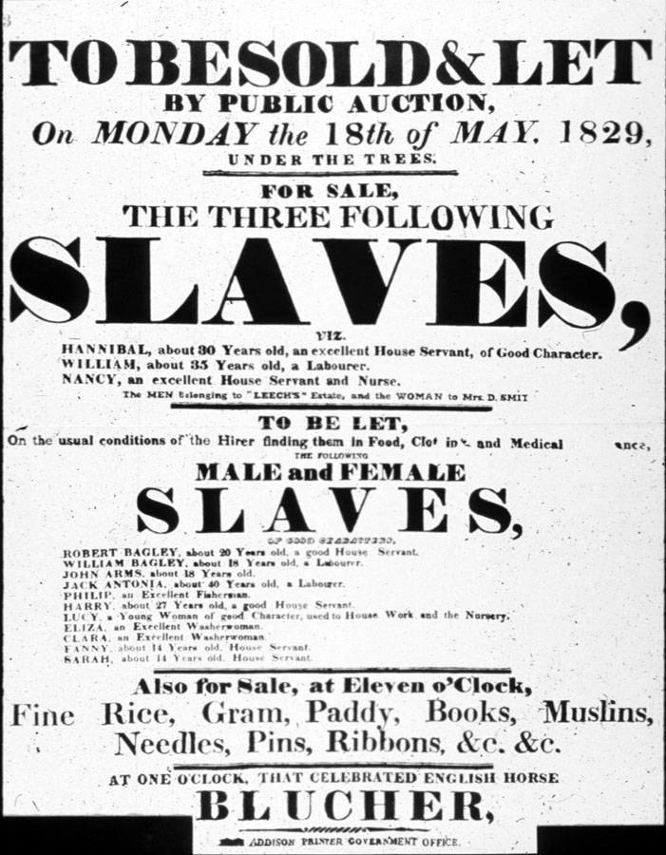
4.
An American slave auction poster

Slide 7
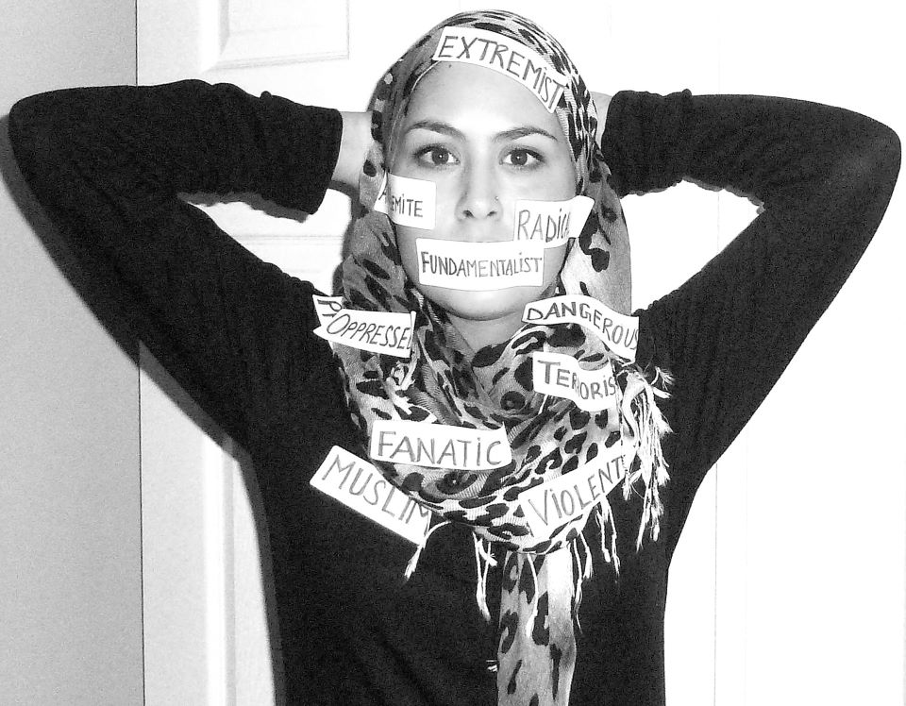
5.
Muslim woman shows how words have dehumanized her

Slide 8
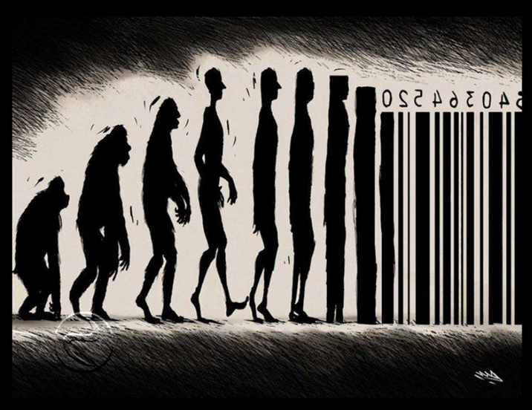
6.
Artwork of people becoming barcodes

