Slide 1
TKaM Character Analysis Infographic

Slide 2
Character Analysis
Complete group questions about your character
Choose who is in charge of what role
Quotationist
Linguist
#PicassoStatus

Slide 3
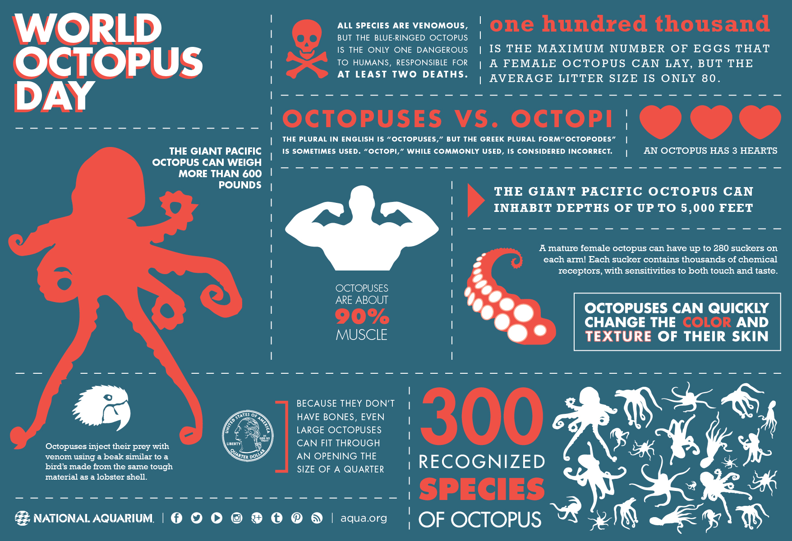

Slide 5
Planning for your group’s infographic…
#PicassoStatus:
Must incorporate your drawing of the character on the infographic
Arrange your pictures in a way that adds to the visual or says something about the character. Be creative!
Linguists:
Must make a word cloud of all your descriptive words about the character
Choose the three most important descriptive words. Make them larger!
Quotationists:
Each quotationist must choose their favorite quote or two quotes about the character.
You must incorporate these quotes with a visual. You can write the quote next to a picture that shows the quote, connect the quote to a word on the word cloud, or create your own visual to explain the quote.

