Slide 1
Art paper: Brainstorming

Slide 2
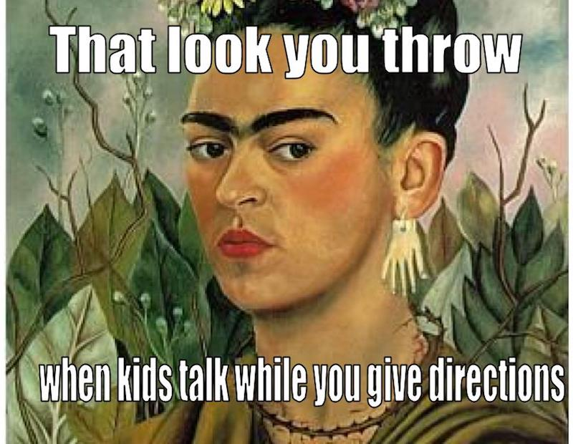
Brainstorming Day: Prove that you were productive . . .
Must list 3 possible topics (big ideas) that you find interesting
list at least 3 pieces of artwork that you potentially could use with each topic (could overlap between topics)
View A LOT of artwork (paintings, sculptures)
Take detailed notes on at least 2 pieces
Read A LOT of poems
List at least 5 poems that you read
Take detailed notes on observation on at least 2
Prove you didn’t waste your time = 15 points (not to shabby for doing what you’re supposed to in an AP class)
If I don’t think you did enough/ you are noticeably off task, you won’t get all the points ☺

Slide 3
With your groups:
Each group member should share (on phone/ipad) 3-5 NGA pieces that you may use in your paper.
Each individual must share the following:
What drew you to the painting?
What have you noticed so far? (Think Quinn tips)
What idea/theme do these images seem to deal with?
Group Members- give feedback on:
Other observations you have about the painting
Yay or nay to topic idea: Do you think the argument is valid?

Slide 4
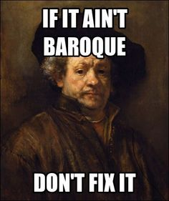
Individually
Work on taking (or adding to) your notes on your 3 pieces
Use Quinn’s 4 steps to art analysis (FYI, this is a whole art world thing, not just Quinn ☺)
Describe what you see
Analyze the elements used
Interpret what the artist is saying
Evaluate the piece (you should focus on 1-3 now)
You must have detailed notes on your 3 pieces
At least ½ page, DETAILED notes for each

