Slide 1
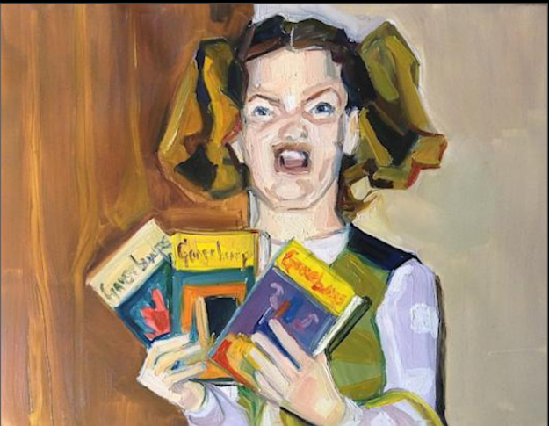
Art History
An exceptionally brief crash-course on 3000 + years of art
Ermahgerd
Ert!!

Slide 2
Stone Age/prehistoric Art (30,000 BC-2500 BC)
Cave paintings, idols
Figurative (symbolic) and nonfigurative (realistic)
Focus: fertility goddesses, animals
Humans = stick figures, animals more realistic

Slide 3
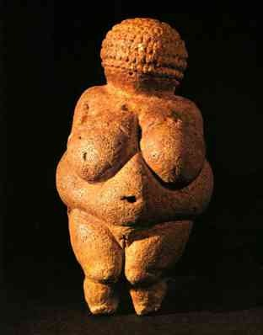
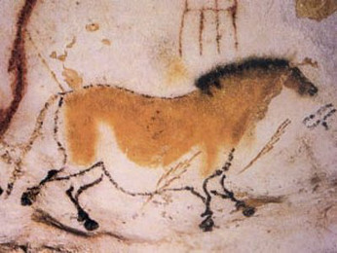
Stone Age/Prehistoric
Lascaux Cave Painting
Woman of Willendorf

Slide 4
Mesopotamian Art/Bronze Age (3500 b.c.–539 b.c)
Warrior art and narration in stone relief
Focus: War, divine, rulers
Glorified powerful rulers, moral stories

Slide 5
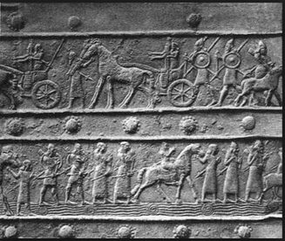
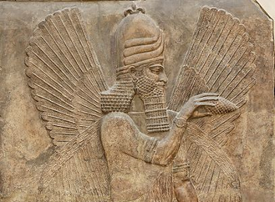
Mesopotamian Art/Bronze Age
Mesopotamian relief sculptures

Slide 6
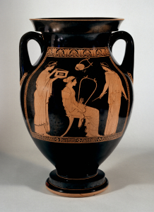
Greek/Hellinistic (850 b.c.–31 b.c)
Greek idealism: balance, perfect proportions; architectural orders
Mortal human and divine depicted
Realistic Human Body in sculpture

Slide 7
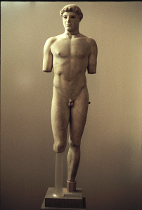
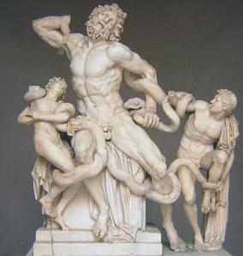
Greek/Hellinistic
Lacoon and his sons
Kritios Boy

Slide 8
Middle Ages (500–1400 AD) Byzantine, Romanesque, Gothic
Blatant Religious (Christian) focus
Ornate, gold, rich colors
Art’s purpose was to depict and clarify the spiritual world.

Slide 9
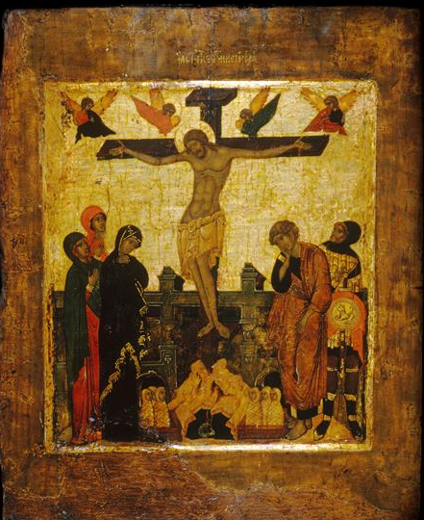
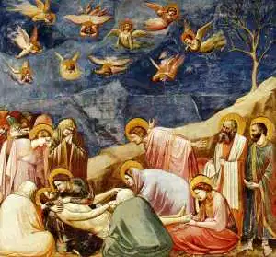
Middle Ages
Lamentation by Giotti di Bondone
Byzantine Crucifiction

Slide 10
Renaissance (1400-1600)
Rebirth of ideals of classical (Greek/Roman) art
Realistic perspective
Early Renaissance: religious themes, some figures and landscapes
Late Renaissance (Beginning of Protestant reformation): Focus on human body and physical reality

Slide 11
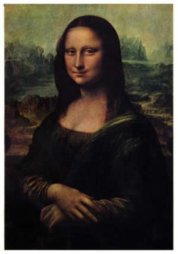
Renaissance
Birth of Venus by Pieter Bruegel
Mona Lisa by Leonardo Da Vinci

Slide 12
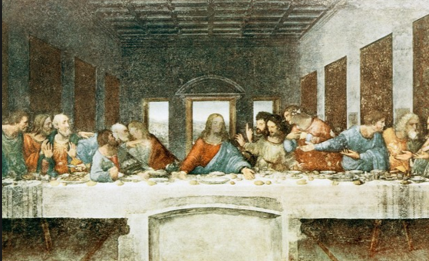
The Last Supper by Leonardo Da Vinci

Slide 13
Baroque (1600-1750
Catholic Counter Reformation
Splendor and flourish for God; art as a weapon in the religious wars
Biblical Scenes: focusing on humanity of religious figures (fewer halos)
Dutch Baroque: landscapes, still lives, every day life

Slide 14
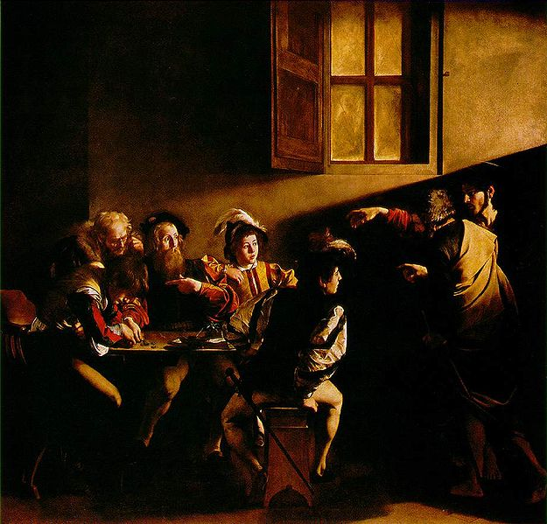
Baroque
Calling of St. Matthew: Caravaggio

Slide 15
Neoclassical (Enlightenment): 1750–1850
Reflect the rational way of thinking (Enlightenment) drew from classical Greek and Roman style
Idealized forms, stable composition
Political, patriotic theme in many
Heroism and civic virtues

Slide 16
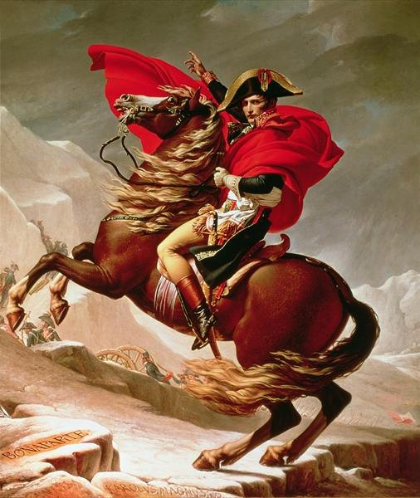
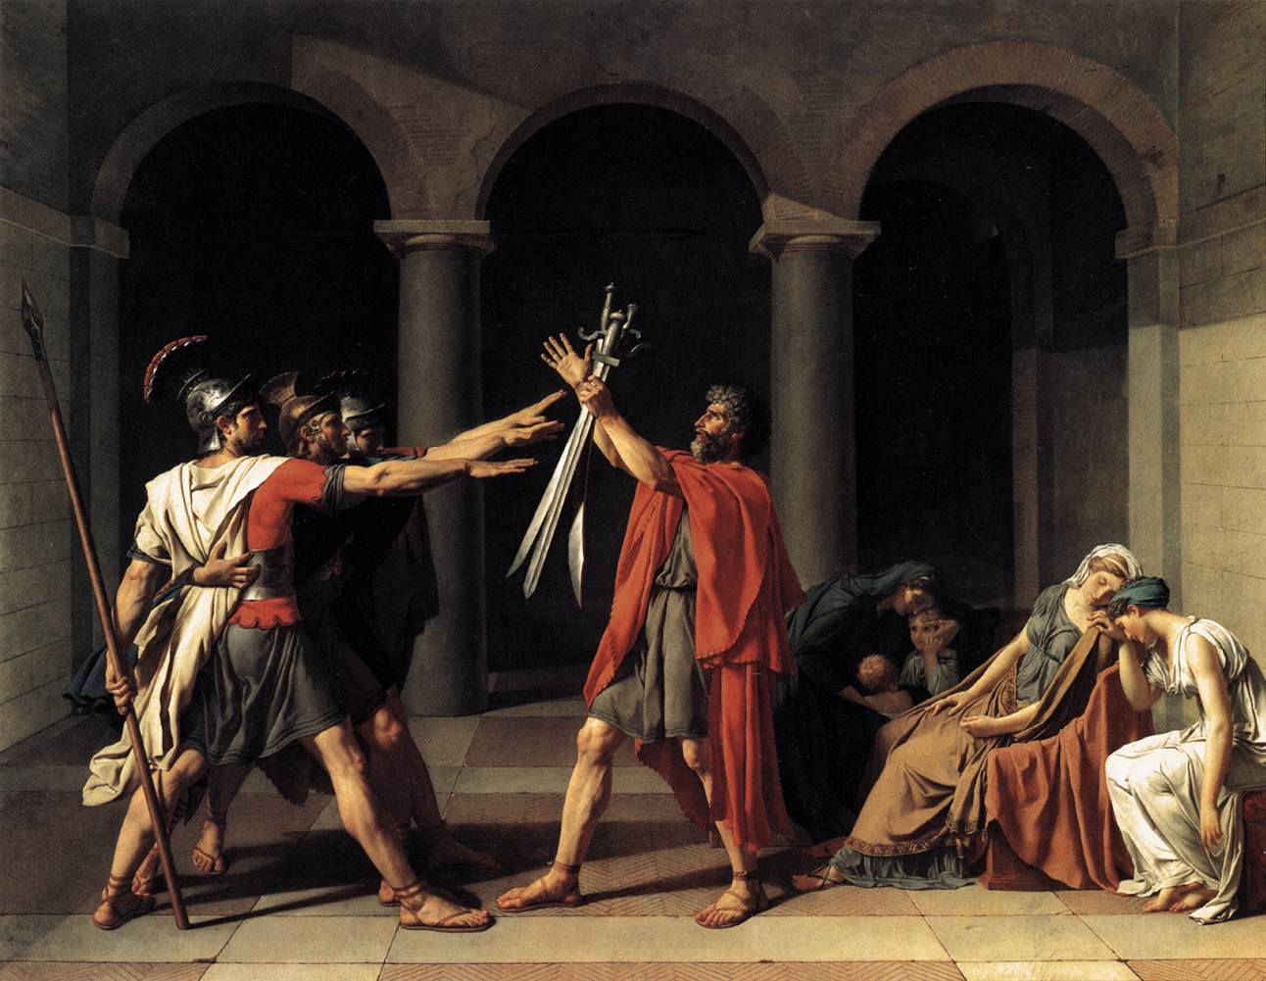
Neoclassical
Oath of the Horatii
by Jacques-Louis David
Napoleon Crossing the Saint Bernard by Jacques-Louis David

Slide 17
Romanticism (1780-1850)
Reaction to Enlightenment: The triumph of imagination and individuality
Emphasis on individual over society
Brighter color, more intense emotion
Landscape scenes

Slide 18
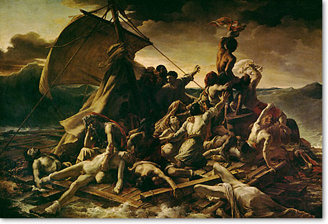
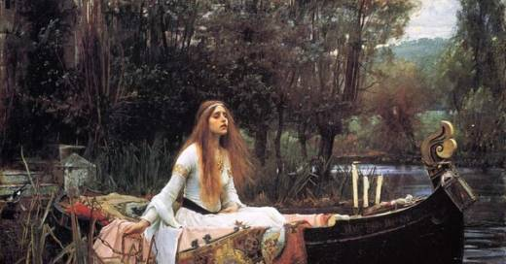
Romanticism
The Lady of Shallott
By John William Waterhouse
The Raft Gericault

Slide 19
Impressionism (1865–1885)
Breaking traditional styles of painting by capturing fleeting effects of natural light
Quick Brushstrokes
Still lifes, landscapes, portraits

Slide 20
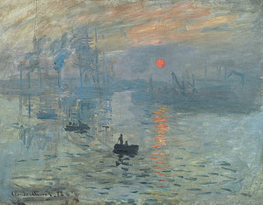
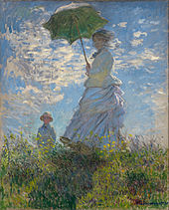
Impressionism
Impressionism Sunrise: Claude Monet
Woman with a Parosole: Claude Monet

Slide 21
Modern Art (postimpressionism, cubism, expressionism, fauvism, futurism) (1885-1970s)
New types of expression
Harsher colors, more abstract
Distortion of form

Slide 22
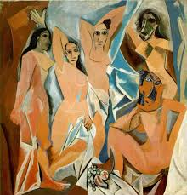
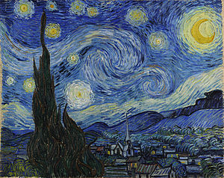
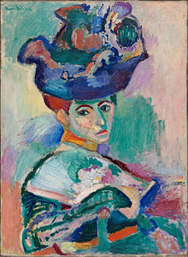
Modernism
Starry Night by Van Gogh (Post-Impressionism)
Woman with a Hat by Henri Matisse (Fauvism)
Les demoiselles d’Avignon by Pablo Picaso (Cubism)

Slide 23
Postmodernism/ Deconstructivism (1970-now)
Art without a center and reworking and mixing past styles

Slide 24
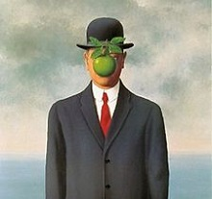
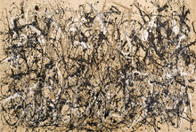
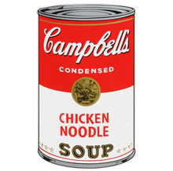
Postmodern
Autumn Rhythm by Jackson Pollock
Campbell’s Soup Can by Andy Warhol
The Son of Man
by Rene Magritte

Slide 25
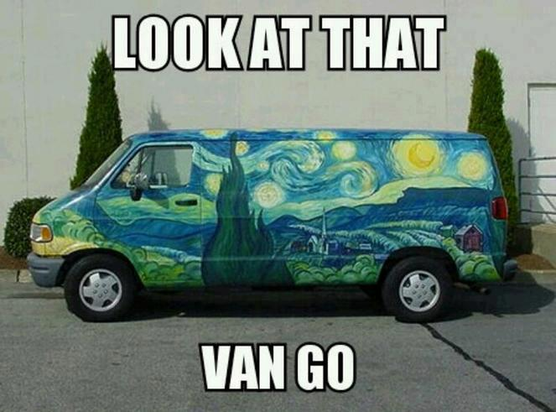

Slide 26
